Slide 1
Visualizing Real-time Hypothetical Scenarios in Tableau
Sinji Yang

Slide 2



Data-driven Decision-Making Processes What is missing in this picture?
Data
Visualization
Decision Making

Slide 3

What if we can visualize hypothetical data & scenarios?

Slide 4


What if we add Hypothetical Data?
Hypothetical
Data
Real
Data
Real
Data
Real
Data

Slide 5

What if we add real-time hypothetical scenarios to Tableau?
Scenarios

Slide 6
Benefits of What-If Scenario Analysis
WISA
WISA can
Evaluate possible outcomes & impacts
See how results change when key factors are changed
Help brainstorming
Trigger new ideas or see potential opportunities
Promote thinking outside the box
Consider alternatives
Improve decision making quality
Have more informed decision-making processes
Reduce uncertainty

Slide 7
Add WISA to Tableau

Slide 8
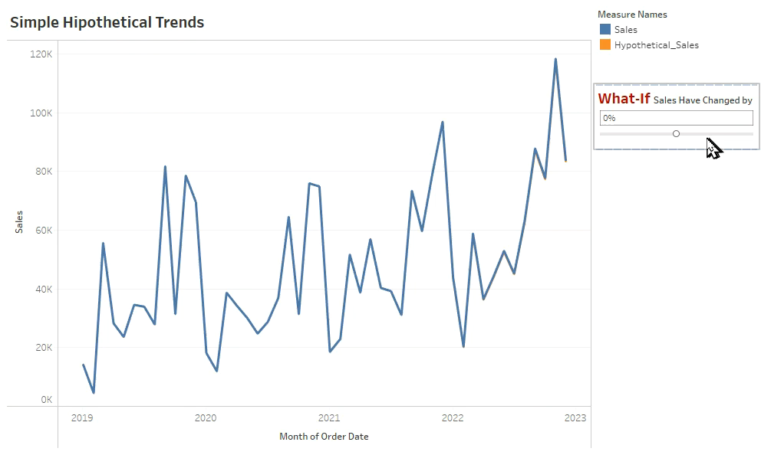

Slide 9
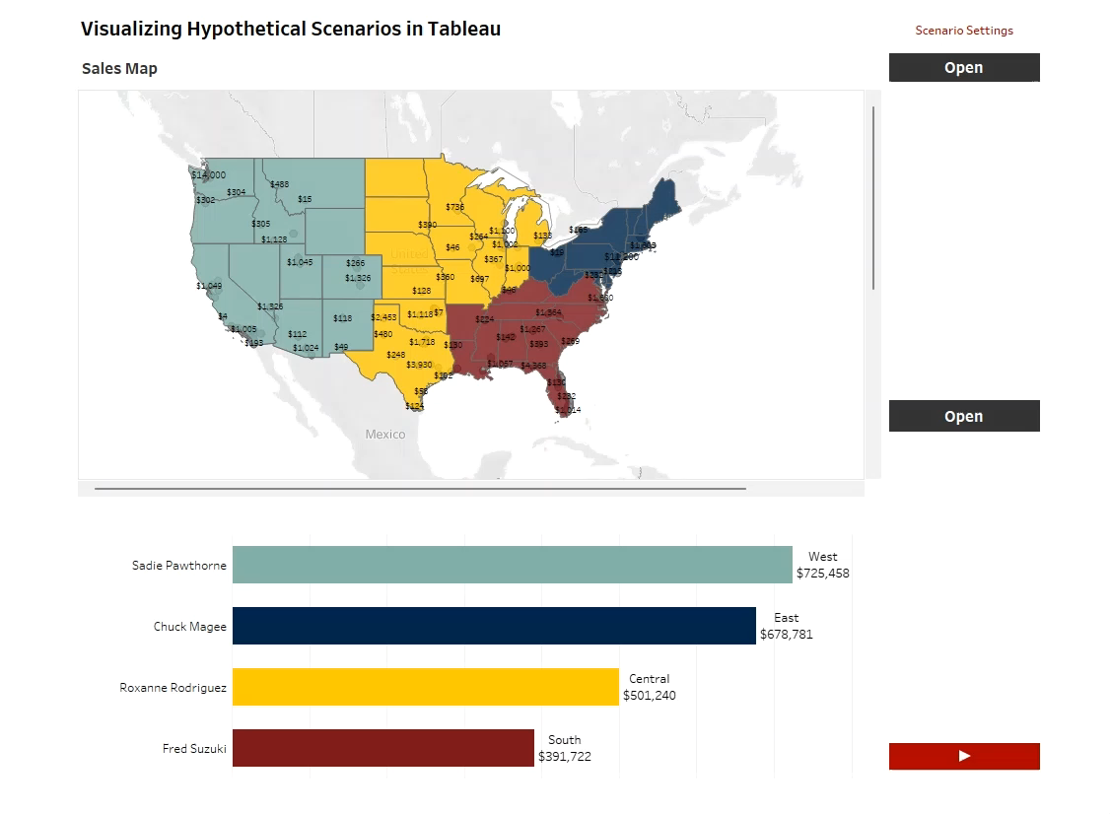
Demo

Slide 10
What is the secret?
Placeholders
Fake records with null value in the columns
Having a fake ID for identification
Examples of Fake IDs
Row # as the fake ID
Negative integer as the fake ID

Slide 11
How do placeholders work in Tableau?
Placeholder records are added to the real data
Tableau automatically disregards the null values
Tableau Parameters receives the real-time hypothetical data from the user
Tableau Calculated Fields assigns data to the placeholders (the hypothetical data only exists in the memory)
The above steps mingle real & hypothetical data together in Tableau.

Slide 12
An Easy Way to Create Placeholders (Sample SQL)
SELECT
Orders.Row_Num*(-1) as ID
, Null as Order_ID
, Null as Order_Date
, …
FROM Orders
WHERE Orders.Row_Num <= 5
Create Fake ID
Nullify columns
Decide how many are needed

Slide 13
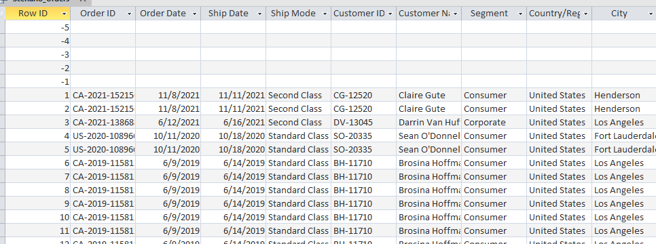
Database Tricks to Add Placeholders
SELECT * FROM Orders
UNION
SELECT * FROM Placeholder_Orders
Save as a DB View
=>Tableau Data Source
UNION statement

Slide 14
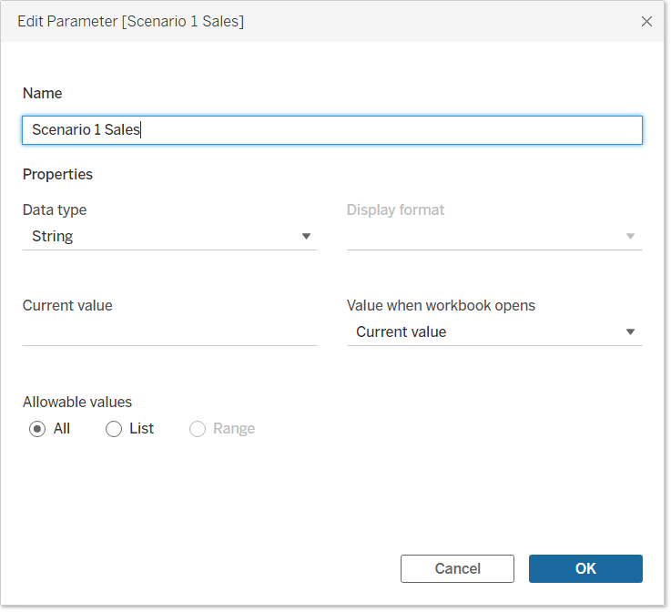
Use of the Tableau Parameters

Slide 15
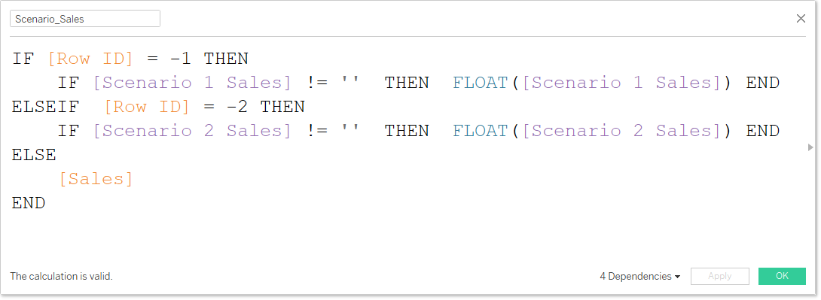
Use of the Tableau Calculated Fields

Slide 16
Use Cases
HE-related Use Cases:
Faculty / staff salary comparisons with hypothetical new hiring
Enrollment forecasts with what-if scenario analysis
Recruitment and ethnicity distribution with hypothetical scenarios
All academic programs (including zero enrollment programs)

Slide 17
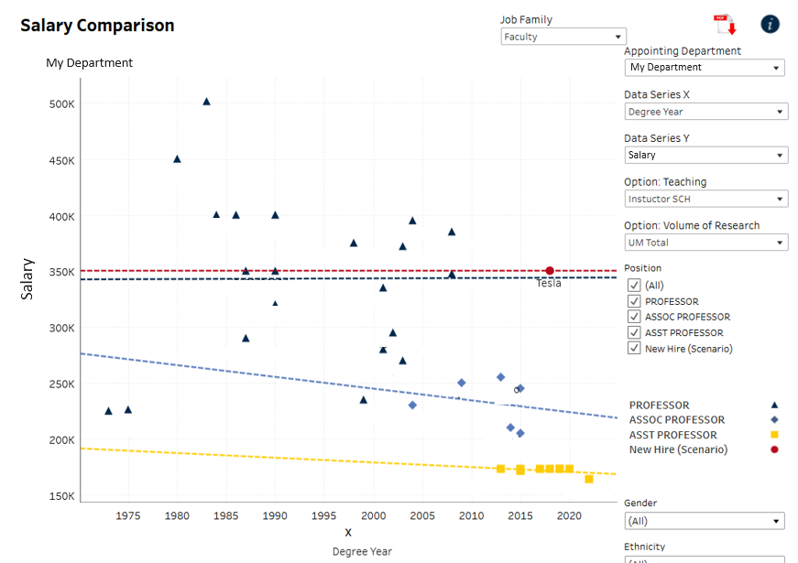

Slide 18
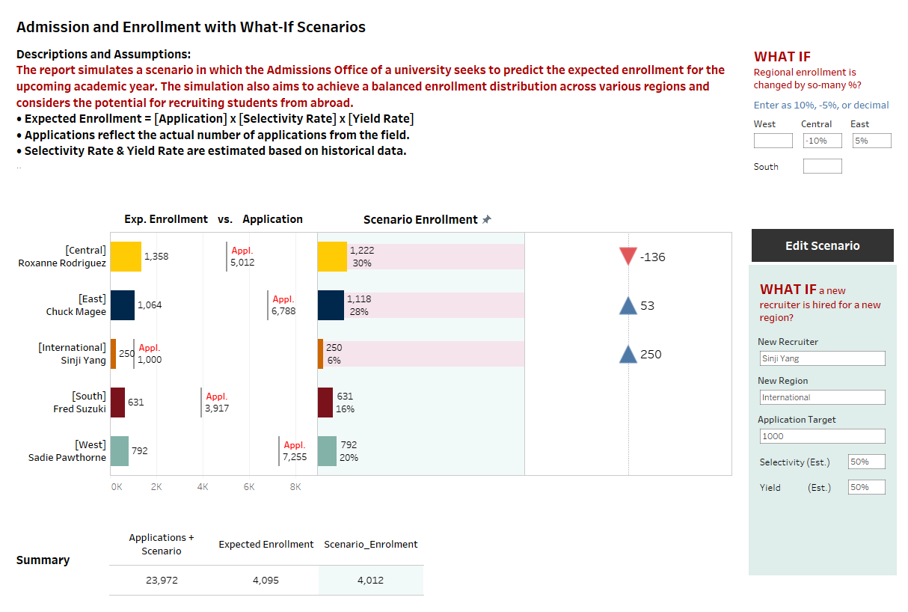
Demo

Slide 19
Considerations of Adding Scenarios
Adding scenarios complicates the report design
Try offering scenarios at a higher-level of data summary
Use a naming convention to label scenario parameters and variables
Document the design and the field calculation logic
If data download is offered, consider offering a pure real data set for users to download.
Show/hide buttons & containers can facilitate the design of a scenario settings interface

Slide 20
Other Use cases of Placeholders
Avoid data table display changes when parameter selection changes
Database LEFT JOIN or CROSS JOIN can also help create placeholder records

Slide 21
Takeaways
Tableau + placeholders can help visualize real-time hypothetical data, and it is easy to add WISA to Tableau
WISA improves decision making processes and quality

Slide 22
Q & A
Contact:
Sinji Yang
sinjiya@umich.edu
Senior BI Analyst
College of Literature, Science, and the Arts
University of Michigan
Reference:
GitHub https://github.com/sinjiya/Visualizing_Real_time_Hypothetical_Scenarios_in_Tableau

